Slide 1
Chapter 16
Launching a Successful
Online Business and EC Projects

Slide 2
Learning Objectives
Understand the fundamental requirements for initiating an online business.
Describe the process of initiating and funding a start-up e-business or large e-project.
Understand the process of adding EC initiatives to an existing business.
Describe the issues and methods of transforming an organization into an e-business.
Describe the process of acquiring Web sites and evaluating building versus hosting options.

Slide 3
Learning Objectives
Understand the importance of providing and managing content and describe how to accomplish this.
Evaluate Web sites on design criteria, such as appearance, navigation, consistency, and performance.
Understand how search engine optimization may help a Web site obtain high placement in search engines.

Slide 4
Learning Objectives
Understand how to provide some major support e-services.
Understand the process of building an online storefront.
Be able to build an online storefront with templates.

Slide 5
Starting a New Online Business
An E-Start-Up Is a Start-Up
  An e-start-up is basically a start-up and, as such, must consider all the issues faced by a physical start up
  Guidelines to avoid dot-com failures:
    The growth rate of the market you plan to enter
    The timing of your market entry
    The revenue flow
    What cycle a market is in

Slide 6
Starting a New Online Business
Steps in Creating a New Company or Adding an Online Project
  Identify a consumer or business need in the marketplace
  Investigate the opportunity
  Determine the business owner’s ability to meet the need

Slide 7
Starting a New Online Business
Five “secrets” to help you come up with the next big thing:
  Do your homework
  Aim for excitement
  Whittle, shape, iterate, repeat
  Get real
  Avoid creating a gizmo

Slide 8
Starting a New Online Business
Online Business Planning
  business plan
  A written document that identifies a company’s goals and outlines how the company intends to achieve the goals and at what cost
  business case
  A document that justifies the investment of internal, organizational resources in a specific application or project

Slide 9
Starting a New Online Business
Funding a New Online Business
  First round of initial funding
    angel investor
    A wealthy individual who contributes personal funds and possibly expertise at the earliest stage of business development
    incubator
    A company, university, or nonprofit organization that supports businesses in their initial stages of development

Slide 10
Starting a New Online Business
  Second round financing
    venture capital (VC)
    Money invested in a business by an individual, a group of individuals (venture capitalists), or a funding company in exchange for equity in the business
  Additional funding: A large partner
  The initial public offering (IPO)

Slide 11
Adding E-Commerce Initiatives or
Transforming to an E-Business
Adding EC Initiatives to an Existing Business
  The most common additions are:
    A storefront
    A portal
    E-procurement
    Auctions and reverse auctions
    Other initiatives

Slide 12
Adding E-Commerce Initiatives or
Transforming to an E-Business
Transformation to an E-Business
  What is organizational transformation?
  How an organization can be transformed into an e-business
  Business process reengineering
  Business process management (BPM)
  Software tools for facilitating transformation to e-business
  Change management

Slide 13
Adding E-Commerce Initiatives or
Transforming to an E-Business
  business process management (BPM)
  Method for business restructuring that combines workflow systems and redesign methods; covers three process categories—people-to-people, systems-to-systems, and systems-to-people interactions

Slide 14
Building or Acquiring a Web Site
Classification of Web Sites
  informational Web site
  A Web site that does little more than provide information about the business and its products and services
  interactive Web site
  A Web site that provides opportunities for the customers and the business to communicate and share information

Slide 15
Building or Acquiring a Web Site
  attractors
  Web site features that attract and interact with visitors in the target stakeholder group
  transactional Web site
  A Web site that sells products and services
  collaborative Web site
  A site that allows business partners to collaborate

Slide 16
Building or Acquiring a Web Site
Steps in Building a Web Site
  Select a Web host
  Register a domain name
  Create and manage content
  Design the Web site
  Construct the Web site and test
  Market and promote the Web site

Slide 17
Web Site Hosting and Obtaining a Domain Name
Web Hosting Options
  storebuilder service
  A hosting service that provides disk space and services to help small and microbusinesses build a Web site quickly and cheaply

Slide 18
Web Site Hosting and Obtaining a Domain Name
  A pure hosting service
    Web hosting service
    A dedicated Web site hosting company that offers a wide range of hosting services and functionality to businesses of all sizes
    mirror site
    An exact duplicate of an original Web site that is physically located on a Web server on another continent or in another country
    co-location
    A Web server owned and maintained by the business is given to a Web hosting service that manages the server’s connection to the Internet

Slide 19
Web Site Hosting and Obtaining a Domain Name
  ISP hosting service
  A hosting service that provides an independent, stand-alone Web site for small and medium-sized businesses
  self-hosting
  When a business acquires the hardware, software, staff, and dedicated telecommunications services necessary to set up and manage its own Web site

Slide 20
Web Site Hosting and Obtaining a Domain Name
Registering a Domain Name
  domain name
  A name-based address that identifies an Internet-connected server. Usually, it refers to the portion of the address to the left of .com and .org, etc.
  domain name registrar
  A business that assists prospective Web site owners with finding and registering the domain name of their choice

Slide 21
Content Creation,
Delivery, and Management
content
The text, images, sound, and video that make up a Web page
Categories and Types of Content
  dynamic Web content
  Content that must be kept up-to-date
  commodity content
  Information that is widely available and generally free to access on the Web

Slide 22
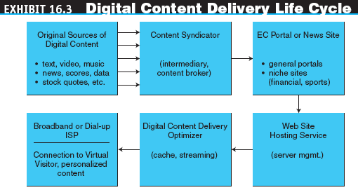
Content Creation,
Delivery, and Management

Slide 23
Content Creation,
Delivery, and Management
Primary and secondary content
  Primary content is information about the product itself
  Secondary content offers marketing opportunities

Slide 24
Content Creation,
Delivery, and Management
  Secondary content
    cross-selling
    Offering similar or complementary products and services to increase sales
    up-selling
    Offering an upgraded version of the product in order to boost sales and profit
    Promotion
    Comment

Slide 25
Content Creation,
Delivery, and Management
Creation or Acquisition
  Buying content
  Buying from a syndicator
    syndication
    The sale of the same good (e.g., digital content) to many customers, who then integrate it with other offerings and resell it or give it away free
    Web syndication
    A form of syndication in which a section of a Web site is made available for other sites to use

Slide 26
Content Creation,
Delivery, and Management
    RSS
    An XML format for syndicating and sharing Web content
    podcast
    A media file distributed over the Internet using syndication feeds. A collection of audio files in MP3 format
  Representative content-related vendors
  Content delivery networks

Slide 27
Content Creation,
Delivery, and Management
  personalized content
  Web content that matches the needs and expectations of the individual visitor
  Delivering content by e-newsletter
    e-newsletter
    A collection of short, informative articles sent at regular intervals by e-mail to individuals who have an interest in the newsletter’s topic
  Writing effective content

Slide 28
Content Creation,
Delivery, and Management
Content Management and Maintenance
  content management
  The process of adding, revising, and removing content from a Web site to keep content fresh, accurate, compelling, and credible

Slide 29
Content Creation,
Delivery, and Management
  Content testing and updating
  Measuring content quality
  Pitfalls of content management
  Content removal
  Content management software

Slide 30
Content Creation,
Delivery, and Management
Catalog Content and Its Management
  For B2B buyers who aggregate suppliers’ catalogs on their own Web sites, content management begins with engaging suppliers and then collecting, standardizing, classifying, hosting, and continually updating their catalog data
Content Maximization and Streaming Services
  Many companies provide media-rich content, such as video clips, music, or Flash media, in an effort to reach their target audience with an appealing marketing message

Slide 31
Web Site Design
information architecture
How the site and its Web pages are organized, labeled, and navigated to support browsing and searching throughout the Web site

Slide 32
Web Site Design
Web Site Design Criteria Navigation
Consistency
Response time
Appearance
Quality Assurance
Availability
Interactivity
Content
Usability
Security
Scalability

Slide 33
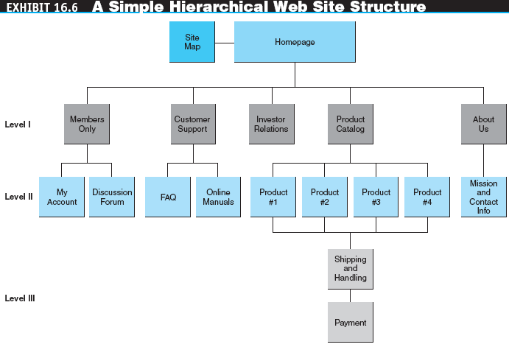
Web Site Design

Slide 34
Web Site Design
site navigation
Aids that help visitors find the information they need quickly and easily
  Site map and navigation
    Frame
    An HTML element that divides the browser window into two or more separate windows
  Performance
  Colors and Graphics

Slide 35

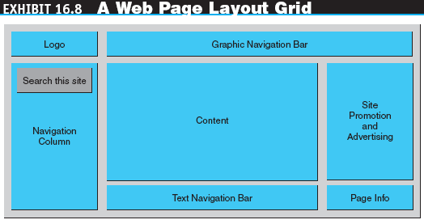
Web Site Design

Slide 36
Web Site Design
usability (of Web site)
The quality of the user’s experience when interacting with the Web site

Slide 37
Web Site Design
  Factors that measure usability:
    Ease of learning
    Efficiency of use
    Memorability
    Error frequency and severity
    Subjective satisfaction

Slide 38
Providing
E-Commerce Support Services
Who Builds the Web Site?
Payments: Accepting Credit Cards
  card-not-present (CNP) transaction
  A credit card transaction in which the merchant does not verify the customer’s signature

Slide 39
Providing
E-Commerce Support Services
  An online business that wants to accept credit cards must:
    Open a merchant account
    Purchase credit card processing software
    Integrate the credit card processing software into the transaction system

Slide 40
Providing
E-Commerce Support Services
Web Site Promotion
  Internal Web site promotion
    signature file
    A simple text message an e-mail program automatically adds to outgoing messages
  search engine optimization (SEO)
  The application of strategies intended to position a Web site at the top of Web search engines

Slide 41
Providing
E-Commerce Support Services
Customer Relationship Management
  The first step to building customer relationships is to give customers good reasons to visit and return to the Web site
  The site should be rich in information and have more content than a visitor can absorb in a single visit
  The site should include not just product information but also value-added content from which visitors can get valuable information and services for free

Slide 42
Opening a Web Storefront
Options for Acquiring Storefronts
  Build them from scratch
  Build them from components
  Build with templates (storebuilders)
  Use someone else’s storefront

Slide 43
Opening a Web Storefront
Selecting a Development Option
  Considerations when defining requirements for a development option:
    Customers
    Merchandising
    Sales service
    Promotion
    Transaction processing
    Marketing data and analysis
    Branding

Slide 44
Opening a Web Storefront
Yahoo! Small Business
  Getting started
  Take a tour
  Using the templates

Slide 45
Managerial Issues
What does it take to create a successful online business?
Is creating a Web site a technical task or a management task?
How do we attract visitors to the Web site?
How do we turn visitors into buyers?
Are best practices useful?
How much of my new business should we give to funders?
How do we save on Web-hosting expenses?

